Slide 1
SQL Server Management Studio

Slide 2
SSMS
MS SQL Server Management Studio is a workstation or a client tool which is used to connect to and manage your SQL Server
SQL Server Management Studio (SSMS) is a windows software or a client tool used to connect and work with our SQL Server from a graphical interface instead of using the command line.
Microsoft SQL Server 2005 launched the management studio to work with SQL Server and Azure SQL databases.

Slide 3
It allows DBAs and database developers to configure, manage, and administer all components within SQL Server.
Its main functionality is to create databases and tables, execute SQL queries for inserting, updating, and deleting data, creating and managing stored procedures, triggers, views, and cursors.
It also enables us to set privileges (securities) on databases and their objects.

Slide 4
SSMS also includes tools for deployment, database health monitoring, and reporting.
It includes SQL Profiler, which allows us to examine the performance of our SQL databases.
It's also possible to use it to schedule background work. If we want to connect to a remote SQL Server instance, we'll need this GUI tool or similar software.
It is used by Administrators, Developers, Testers, etc.

Slide 5
SSMS System Requirements
The following are the requirements to install the current release of SSMS when used with the latest available service pack:
It will support the below Operating Systems:
Windows 10 (64-bit) version 1607 (10.0.14393) or later
Windows 8.1 (64-bit)
Windows Server 2019 (64-bit)
Windows Server 2016 (64-bit)
Windows Server 2012 R2 (64-bit)
Windows Server 2012 (64-bit)
Windows Server 2008 R2 (64-bit)

Slide 6
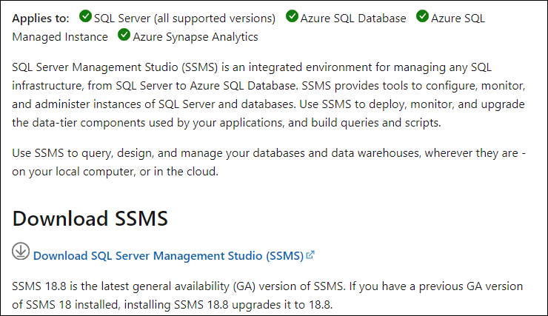
How to Download and Install SQL Server Management Studio (SSMS)
We can use the following steps to download and install Microsoft SQL Server Management Studio (SSMS) in the Windows system:
Step 1: Go to the official page by clicking on this link and click on Download SQL Server Management Studio 18.08. Immediately the SSMS setup starts downloading on your system.

Slide 7
Step 2:Once the file has been downloaded, it will be named "SSMS-Setup-ENU.exe." Now, double-click on it to continue.
If you see the prompt message "Do you want to allow the following to make a change this computer? Say YES.
Step 3: We will see a below window. Here, we can change the installation location and then click the 'Install' button for installing SQL Server Management Studio (SSMS) on your device.

Slide 8
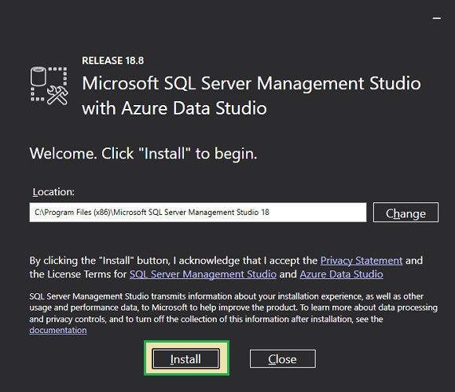

Slide 9
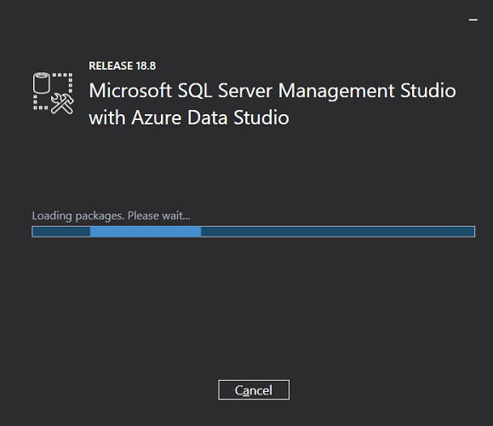
Step 4: The installation process will start. We will see the progress of the packages and the overall progress on the below screen. Since it downloads the necessary packages from the internet, the installation can take some time.

Slide 10
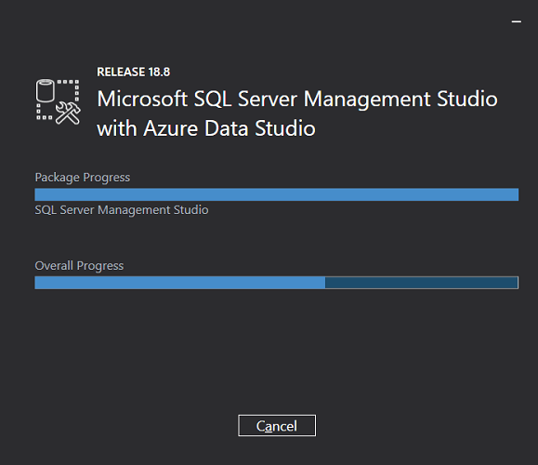

Slide 11
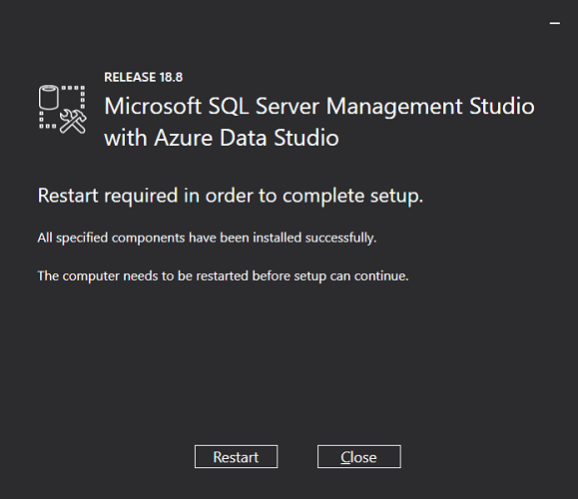
Step 5:When SSMS Setup is finished, it will show the screen below with the "Setup Completed" message. It's possible that we may prompt us to restart our computer.

Slide 12
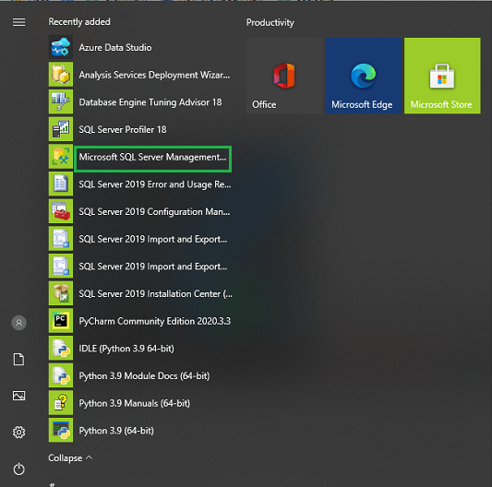
How to access SQL Server Management Studio
We can use the following steps to access SQL Server Management Studio (SSMS):
Go to Start Menu>Programs>Microsoft SQL Server Tools 18> Microsoft SSMS 18.

Slide 13
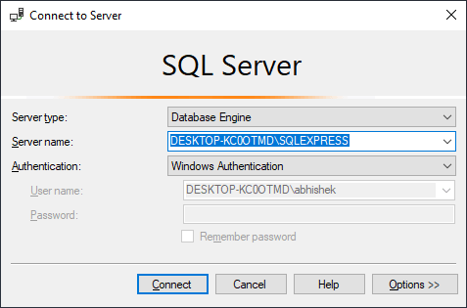
The 'Connect to Server' dialogue screen will appear in front of us when we start SSMS.
Set the Server name and Authentication type of the SQL Server we want to connect to on this screen, then click the Connect button to be connected to 'Data Management Studio’.
Here the server name defaults to the name chosen during the installation of the MS SQL server.

Slide 14
Server type:
It is a dropdown menu that allows us to choose one of four MS SQL services options.
Here we'll be working on the 'Database Engine' that enables us to create and work with databases.
Some of the examples of other server types are Analysis, Reporting, and Integration Services.
Server name:
It is the server's name where MS SQL Server is installed, and we will need to connect with that server.
In most cases, we refer to the server name as "Machine name/Instance.“
Here we had given the Instance name to the SQL Server instance during installation.

Slide 15
Authentication:
If we use "Windows Authentication" during SQL Server's installation, this option is set to "Windows Authentication."
Authentication will be set to "SQL Server Installation" if we have chosen "Mixed Mode (Windows Authentication & Windows Authentication)."
User name\Password:
These two fields will be needed when the Authentication is set to other than "Windows Authentication," such as "SQL Server Installation."

Slide 16
How to access SQL Server Management studio using Command line?
We can also use the Window Command Line tool to launch SQL Server Management Studio. We can do this by using the complete path to ssms.exe. The default location and file name are as follows:
C:\Program Files (x86)\Microsoft SQL Server Management Studio 18\Common7\IDE
Exe name: ssms.exe
The steps to access Management Studio through the command line are as follows:
Type CMD into the Search box to open Command Prompt.
Next, we need to type the complete path followed by ssms.exe and press Enter.

Slide 17
